Slide 1

Please return this to your child’s class teacher during the home visit in September.
This book is all about me!
This is me…
My name is:

Slide 2
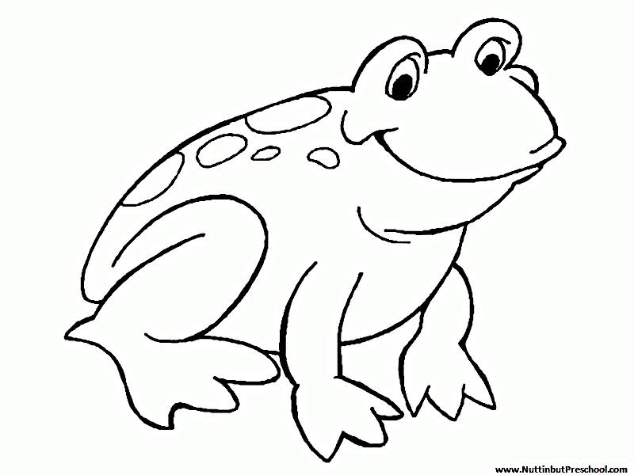
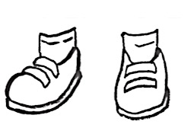




I used my left/right hand to colour in these pictures:
Black
Green
Blue
Grey
Purple
Yellow

Slide 3
This is my family …
My family members are:
Include the names of family members and the ages of siblings.
These are other people who are important to me…
Other people who are important to me could be friends, childminder, home visitor or speech and language therapist (people I see regularly).

Slide 4
I like:
I am good at:
My favourite stories and rhymes are:
My family and I celebrate:

Slide 5
I need help with:
I don’t like:
What I would like you to know about me:
What my parent/carer would like you to know about me:

Slide 6
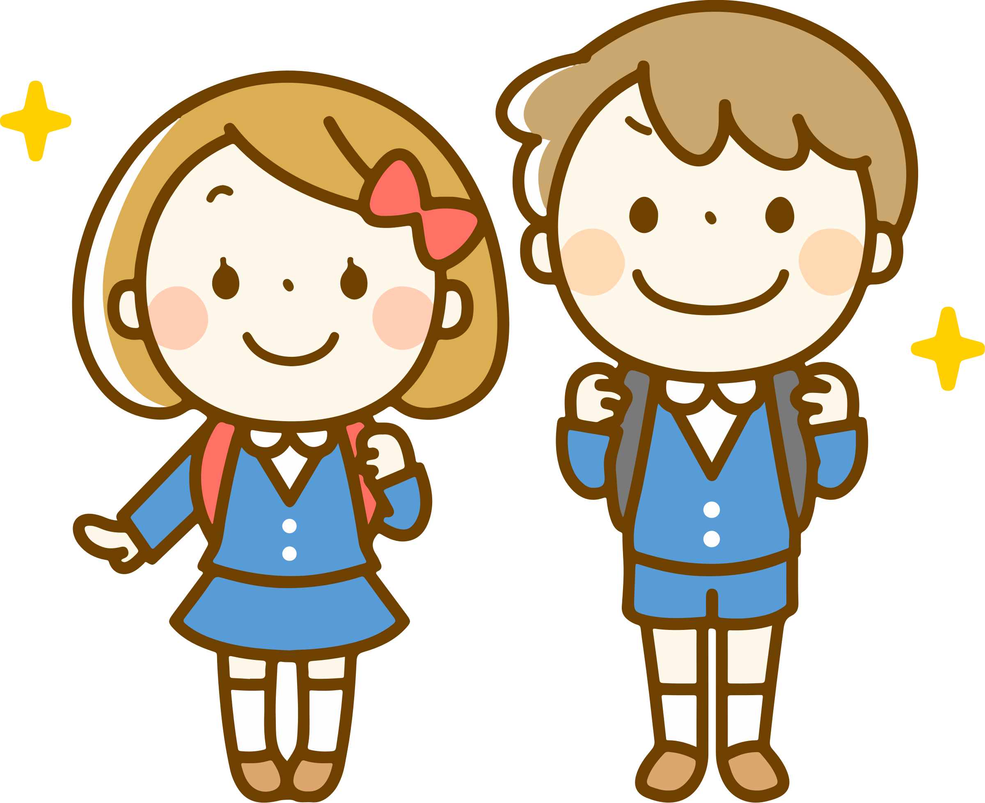
Draw a picture of yourself doing something you enjoy.
You look great.

Slide 8

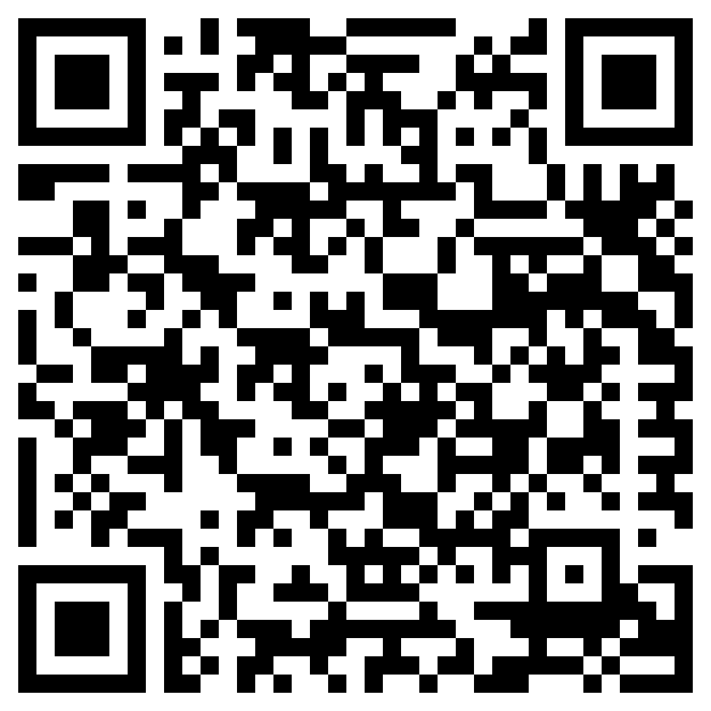

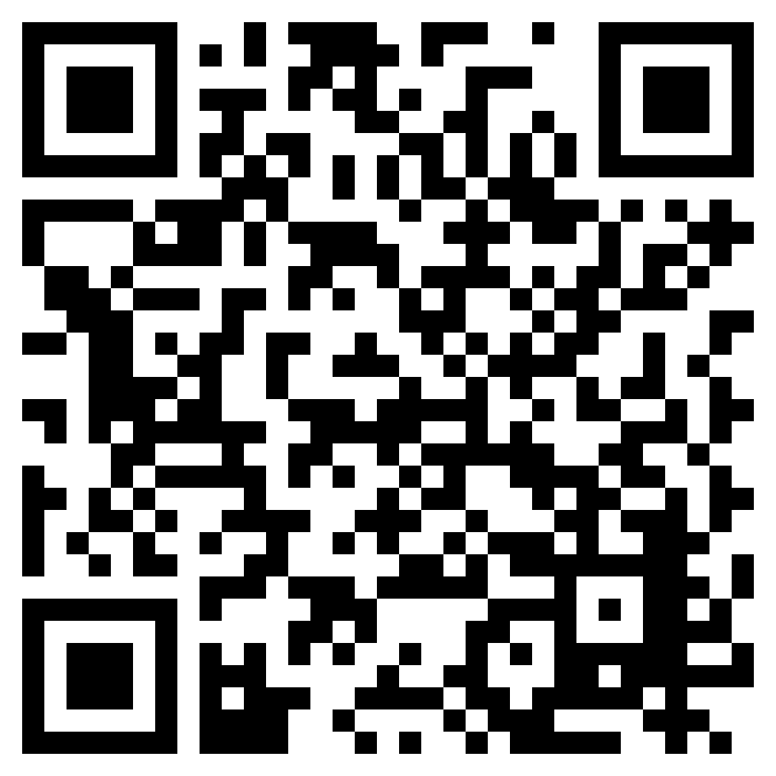

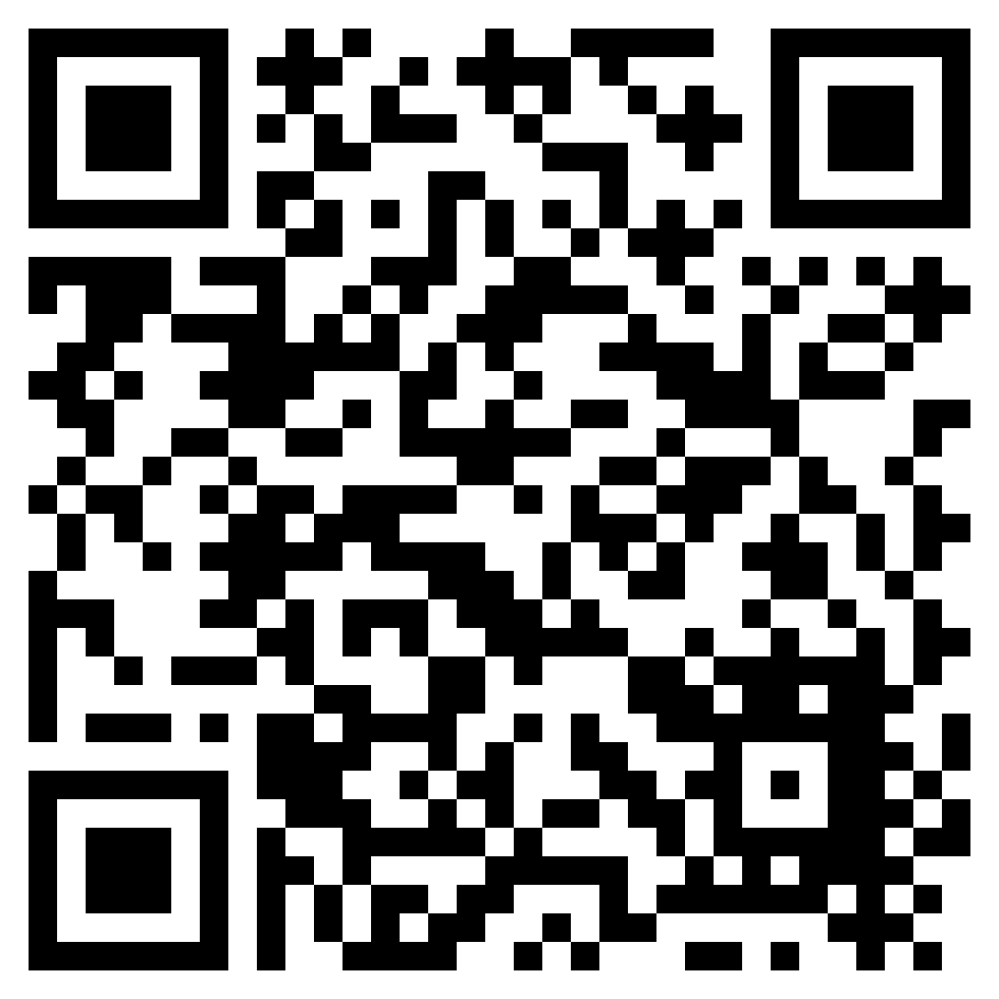
Some resources to help your child prepare for school
Visit our school website for information, workshops, stories and videos.
Visit the book trust for a list of books that are perfect for preparing your little ones for school.
Visit the pacey website for resources to help you and your child prepare for school.

Slide 9
things to do over the summer
Cook up a storm. Bake some healthy snacks and have a party.
Use a spoon and go drumming outdoors. How many sounds can you make?
Press play and start a tidy up party in your house. Make a playlist.
Make some playdough and practise using a knife and fork to cut it up.
Draw, paint, cut, get out the recycling. What will you create?
Build a fort, make a den or put up a tent.
Become more independent: zip up coats, put your shoes on.
Hide your family members names around the house and see if you can find yours first.
Run, jump, slither, laugh and scream until you are exhausted.
Make someone else smile by doing something kind.
Help with jobs around the house, sorting the washing and setting the table.
Play your favourite board game or complete a jigsaw.
Learn and sing familiar songs and rhymes.
Go on a shape hunt – look for triangles, squares, circles and rectangles.
Read lots of stories. Change character voices as you read each time.
Play ball games: football, throw, catch. Throw it high, throw it far!
Practise washing your hands carefully using soap and water.
Say please and thank you.
Go on a listening walk. What can you hear?
Frogmore here I come!
What numbers can you find all around you?

